Slide 1
2022-2024
Saline Memorial Hospital
Community Health Improvement Plan
- Saline County, Arkansas -
Paper copies of this document may be obtained at: Saline Memorial Hospital
1 Medical Park Dr, Benton, AR 72015 or by phone 501.776.6000 or via the hospital website. Salinememorial.org

Slide 2
TABLE OF CONTENTS
Overview
03
Community Health Improvement Plan
05

Slide 3
Overview
About Saline Memorial Hospital
As one of the fastest-growing counties in Arkansas, Saline County has seen an increase in young families moving to the community, and Saline Memorial Hospital (SMH) has grown during the past 60 years to meet the demand for quality, convenient healthcare. More than 180 active and consulting physicians work by the side of trained health professionals to provide highly skilled, compassionate care.
At Saline Memorial Hospital, patients can expect quality healthcare with a personal touch. As a 177-bed, community hospital and one of the largest employers in Saline County, Saline Memorial continually works to expand services to better meet the needs of patients and local residents.
The main hospital campus encompasses approximately 400,000 square feet of Inpatient and Outpatient treatment areas. Services range from cardiology, neurology, pediatrics, orthopedics, otolaryngology, ophthalmology, psychiatry, wound care, bariatric surgery, sleep medicine, women’s services, hospice, home health, breast imaging, emergency services, diagnostic imaging, rehabilitation services and more.
Mission
Making Our Communities Healthier
Vision
We want to create places where people choose to come for healthcare, physicians want to practice and employees want to work.
Values:
Honesty
Integrity and Trustworthiness
Inclusion
Compassion
Legal and Ethical Compliance

Slide 4
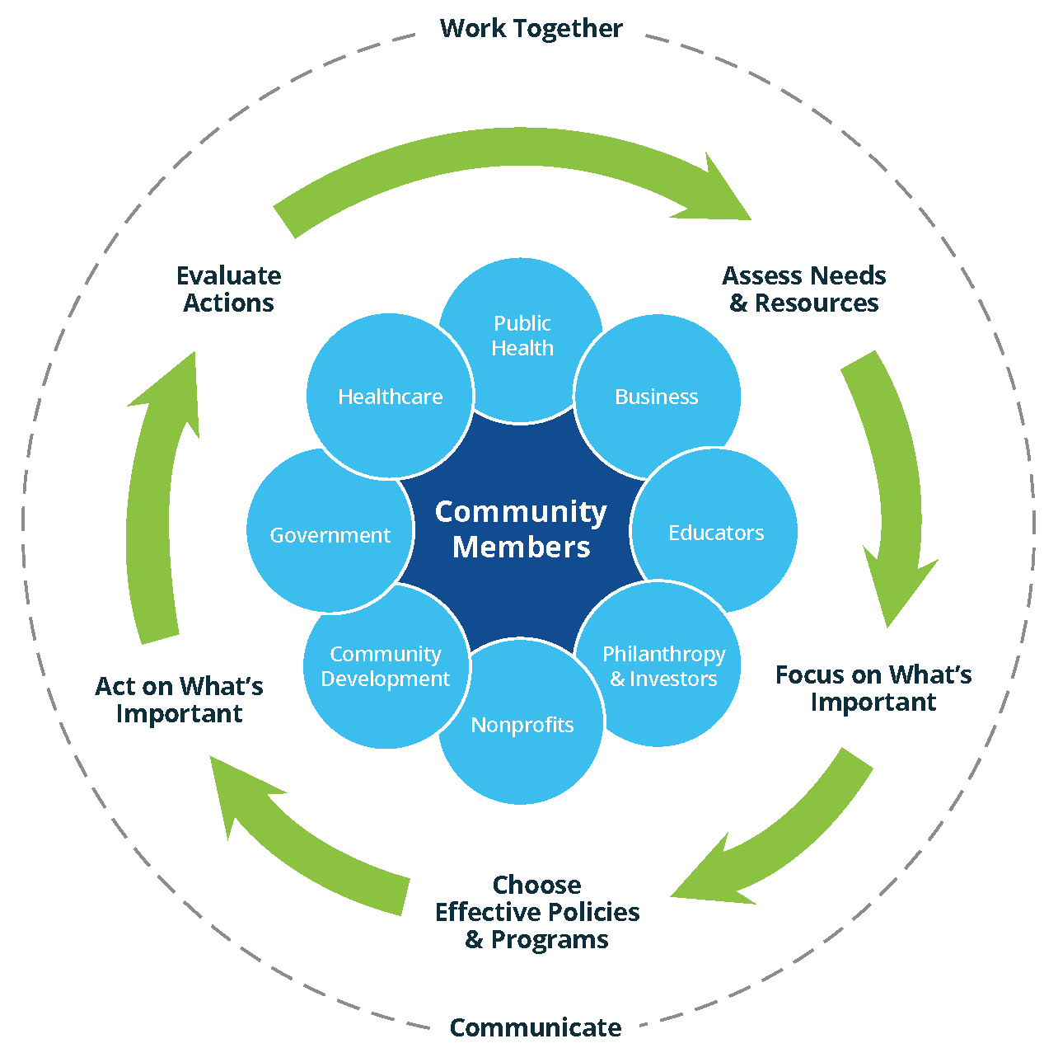
Creating a culture of health in the community
Action Cycle Source: the Robert Wood Johnson Foundation’s County Health Rankings website: http://www.Countyhealthrankings.org/roadmaps/action-center
The Community Health Needs Assessment (CHNA) defines priorities for health improvement, creates a collaborative community environment to engage stakeholders, and an open and transparent process to listen and truly understand the health needs of the community served by Saline Memorial Hospital (Saline County, AR). This document is the Saline Memorial Hospital’s (SMH) Implementation Plan outlining how the hospital plans on addressing significant health needs in the community.
The CHNA is contained in a separate document.
Saline Memorial Hospital’s board of directors approved this assessment on January 4, 2022.
Starting on November 1, 2021, this report is made widely available to the community via Saline Memorial Hospital’s website https://www.salinememorial.org and paper copies are available free of charge at Saline Memorial Hospital, 1 Medical Park Dr, Benton, AR 72015 or by phone (501)776-6000.

Slide 5
Community Health
Improvement Plan
To successfully make our community healthier, it is necessary to have a collaborative venture which brings together all of the care providers, citizens, government, schools, churches, not-for-profit organizations and business and industry around an effective plan of action. The community health needs assessment was completed previously and posted on SMH’s website.
Based on the results of the CHNA, SMH has selected five of the identified significant health needs to address. These are not in particular order.
Substance use disorder
Mental health
Obesity – healthy weight
Chronic diseases
Health literacy
…………………………………………………………………………………………………………..
SUBSTANCE USE DISORDER
SMH plans to meet the significant health need by:
In collaboration with the Saline Health Foundation, the hospital is implementing a program where patients who are admitted due to overdose or opioid addiction are provided a NARCAN kit and connected with a peer recovery specialist as part of the treatment plan. In the past, doctors would provide a prescription for the kits, which often went unfilled. Now, they will have them on hand. The peer recovery specialists have lived experience with substance abuse, trauma and/or psychiatric diagnoses, and they are equipped to help the patients find the resources they need to make a lasting change.
The peer recovery specialists are also onsite at the hospital, and they respond to needs as they arise. Case managers present the option to patients, and if they are agreeable, the case manager will contact the peer recovery specialists. This can occur in any department, from acute care, ICU, etc. The peer recovery specialists also speak at every new hire orientation, creating awareness among the hospital employees, who not only have it for patients in the hospital, but can also share with their friends and neighbors personally. We are looking into in the future making a connection between the hospital’s growth and outreach coordinator to help the peer recovery specialists create awareness among other non-employed providers and community members.
SMH is also exploring opportunities to offer a detox unit at the facility This would include allocating beds specifically to address the need for detox.

Slide 6
Community Health
Improvement Plan (Continued)
4. Saline has sponsored the Beat Goes on 5K and will continue to be a sponsor. This race raises money to purchase and place AEDs and NARCAN kits in local schools and with community leaders, like police and fire. The anticipated impact of these programs is not only immediate treatment of the need, but ongoing life-changing potential through working with the peer recovery specialists.
…………………………………………………………………………………………………………
MENTAL HEALTH
SMH recognizes the need for recruiting a psychiatrist or finding partners who can provide mental health providers in an acute care setting. This is a significant challenge in today’s environment, but we are actively seeking to meet this need for the Saline County community.
Hospital representatives increase awareness of our facility's mental health services that address abuse and suicide prevention with hand-outs, fact sheets, emails, website info, social media, etc.
SMH participates in community events in hospitals, senior centers, community centers, churches, etc. to share above information with members of our community.
SMH staff provides mental health education workshops for healthcare professionals and community members to improve awareness and help patients, friends and family members cope with their conditions. For example, we partner with UAMS to do Alzheimer’s/dementia and schizophrenia simulation experiences that show people what it is like to have those conditions.
SMH hosts a monthly support group for caregivers of Alzheimer’s and dementia that can be joined in person or online.
The anticipated impact of these programs to help those affected by mental health conditions understand their condition better and get the appropriate treatment. We also hope to help their friends and family learn how to support them as they learn to cope.
…………………………………………………………………………………………………………..
OBESITY – HEALTHY WEIGHT
SMH employs a bariatric coordinator and bariatric dietician. Together, they host weekly support group sessions that are open to the public as well as our weight loss patients. These are promoted in the local paper as well as on social media.

Slide 7
Community Health
Improvement Plan (Continued)
2. The support group also has a closed group on Facebook for the group members to connect electronically to share experiences, solutions and other support.
3. SMH’s Weight Loss Center employs three surgeons: Dr. Rex Luttrell, Dr. Kristin Patton and Dr. Lewis Porter and is bringing on a fourth, Dr. Jean Salem, in August 2022. These doctors are widely known and respected in the community, (Dr. Porter was voted Best Surgeon in AY’s Best of 2022) and they share vlogs and articles talking about obesity and weight control.
4. In an effort to encourage health among our own staff, SMH participates in the Vitality program, which awards points for activities that promote a healthy lifestyle, like getting more physical activity.
……………………………………………………………………………………………………………
CHRONIC DISEASES
SMH is dedicated to educating the community about prevention, response and treatment for chronic diseases, like cardiovascular disease. Over the last two years, we earned accreditation as a chest pain center with primary PCI through the American College of Cardiology. We also recently received the 2022 Silver Performance Achievement Award from the ACC. The award and accreditation mean the hospital continually engages in a quality improvement process using data to help identify and drive improvement efforts and ensure adherence to guideline recommendations.
As part of the accreditation, SMH is also responsible for educating the community about cardiovascular disease. So, the team attends community events and health fairs to provide blood pressure screenings and share information about the signs of heart attack and how to respond.
SMH participates in the UAMS’s Institute for Digital Health & Innovation Stroke Program (formerly known as AR SAVES), which delivers live, telemedicine-based, neurology consultations in emergency departments across the state. Involvement in the program includes sharing information via social media and also doing community outreach regarding recognizing the signs.
SMH actively collaborates with ARORA and Donate Life America, including supporting Donate Life Month, where we shared testimonials from a living donor, raised a Donate Life flag to fly throughout the month, participated in a photo competition.
SMH continues to host monthly diabetes support group meetings that are free and open to the public. SMH also hosts an annual Diabetes Health Fair every November and invite the community in for free health screenings, cooking demos and education. SMH dieticians

Slide 8
Community Health
Improvement Plan (Continued)
also provide diabetic counseling to all of our patients. SMH's acute rehabilitation representatives visit the Bryant Senior Center each month and provide free screenings to their members in hopes of catching pre-hypertension.
One out of every three American suffers from a sleep disorder. If left untreated, sleep disorders can develop into more severe health issues, which may include heart problems, difficulty concentrating, irritability and pain sensitivity. Under the leadership and expertise of our board-certified sleep specialists, SMH offers a comprehensive approach to the diagnosis and treatment of sleep disorders in our Sleep Center.
……………………………………………………………………………………………………………..
HEALTH LITERACY
In addition to the community education efforts listed under the other bullets, such as community events, social media and health screenings, SMH is evaluating the feasibility of using radio endorsements by well-known community members, like Broadway Joe on Power 92.
In 2021, we worked with Alpha Kappa Alpha to provide COVID clinics for the Hispanic and African American communities in Saline County. We will continue to partner with AKA to provide community support these communities in the Ralph Bunch area with giveaways and health education.
Saline physicians and hospital workers offer free physicals to local school districts who need them to participate in sports or other extracurriculars. These events are on-site at the schools in the evening, making it convenient for families to get access to a free physical for children. It also introduces the doctors to the community so that they can get to know them and be more conscious of the health resources available for students.
The anticipated impact is that this will educate the community on health care conditions and available resources.
SMH does not intend to address the following significant health needs:
Due to resource limitations, we are not addressing access to care, insurance and transportation or housing.

Slide 9
Community Heath Improvement Plan

